Slide 1
FROM LEGACY ACHAP TO NEW ACHAP
TACKLING THE TASKS AHEAD FOR A HEALTHTY AFRICA
DR. JEROME O. MAFENI – CEO ACHAP

Slide 2
ACHAP was created in a time of crisis, without a clear roadmap ahead
Crisis Situation
Botswana’s high HIV prevalence rate (UNAIDS: 35.8% of adults) had led to precipitous declines in life expectancy, and was threatening to reverse the country’s development gains
External Pressure
Civil society actors were actively calling for governments and the pharmaceutical industry to respond to the crisis (though major global institutions remained skeptical of the feasibility of treatment)
Merck
Gates Foundation
Government of Botswana
ACHAP responded quickly to the HIV/AIDS crisis in Botswana
Merck and its partners leveraged strong ties with the Government of Botswana and the political will of leaders like President Mogae to establish ACHAP in swift fashion between 1999 and 2000

Slide 3
Phase I (2001-2009)
The BMGF and TMCF each contributed US$50 million for ACHAP Phase I.
ACHAP supported the GoB in establishing one of Africa’s most successful public sector HIV/AIDS treatment programmes through:
assistance with infrastructure development, training of health care workers, provision of equipment and drugs, and systems strengthening.

Slide 4
Phase II (2010 – 2014)
In 2010, ACHAP launched Phase II with funding from BMGF amounting to US$15 million and TMCF funding is US$26 million covering 2010-2014 (Orig. $30M each).
Funding was to support the prevention of new HIV infections, transition the ART programme to the Ministry of Health, and strengthen the Government of Botswana’s TB/HIV programme.
Outcomes shared today.

Slide 5
Phase III (2015 – forever)
What should happen to ACHAP? – To be or not to be?
If ACHAP remains, what should it do?
How will it be funded?
Will it survive?
What should be the long-term vision?

Slide 6
ACHAP going forward: critical questions
Where?
What?
How?
Who?
When?
Where will ACHAP work?
Botswana?
SADC?
Sub-Sahara?
Further?
What will ACHAP do?
HIV/AIDS?
TB?
NCD?
Other health?
Non health?
How will we get there?
Skills?
Structures?
Cost?
Partners?
Who will pay for it?
Donors?
Govt?
Private Sector?
Investors?
Self financing?
Other?
When will we do it?
Expand in existing markets?
Enter new markets?

Slide 7
ACHAP VISION & MISSION
Vision: “To provide comprehensive, innovative and catalytic solutions through Public Private Community Partnerships (PPCP) to achieve sustainable population health”.
Mission: To be the leading innovator for promoting a healthy Africa.

Slide 8
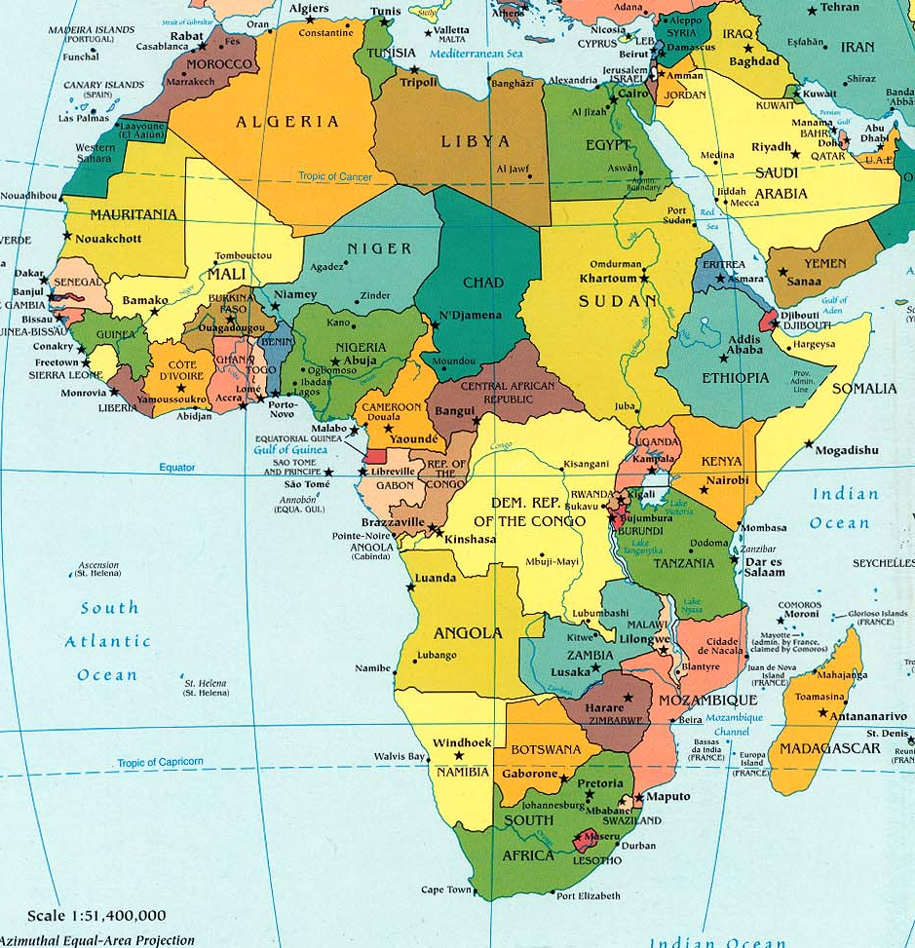
Our Vision for Growth

Slide 9
Africa’s Key Health Challenges
High HIV & TB Burden including Malaria
High maternal & infant mortality
Seasonal and emerging epidemics (Ebola)
Non-Communicable Diseases
Cancers and mental illness
Hypertension and Kidney disease
Diabetes and Obesity
Severe shortage of health workers
Crumbling public health infrastructure
Poor health Systems

Slide 10
Sub Saharan Africa: funding
Sub-Saharan Africa receives largest share of global health funding: 47.4%
Health activity | Share of health funding
HIV / AIDS | 40.2%
Basic Health and Medical Care | 14.8%
Human Capacity development | 13.2%
Family Planning & Reproductive health | 13.2%
Malaria | 8.7%
Source: Kaiser Foundation 2010

Slide 11
Official Development Aid (ODA) Disbursements US$ millions (OECD / World Bank)
2007
2008
2009
2010
2011
Total ODA
Health ODA

Slide 12
Where?

Slide 13
Market development
ACHAP will continue supporting the health sector in Botswana
Concurrently ACHAP will move into new markets:
Primary focus (2015-2016):
Lesotho
Swaziland
Zambia
Secondary focus (2017 onwards)
Malawi
Zimbabwe
South Africa
Mozambique

Slide 14
What?

Slide 15
New health interventions
ACHAP will continue to work in HIV
Treatment
Prevention
TB/HIV co-infection
Concurrently ACHAP will move into new health sectors:
Maternal & Child Health
Sexual & Reproductive Health
Non Communicable diseases
General wellness
Obesity
Cardio-vascular
Diabetes

Slide 16
How?

Slide 17
The 5i health outcomes model
ACHAP will utilize our proven 5i model to deliver high impact health outcomes in Botswana and new markets.
Innovate
Develop unique solutions to developing country health challenges through multi-sectoral interaction
Incubate
trial projects on a small scale with intense data management and learning
Increase
Bring projects to national scale to support improved health outcomes
Integrate
Move projects to direct government management for long term sustainability.
Improve continuous monitoring, evaluation, testing of new products and systems

Slide 18
Franchising and partnerships
ACHAP will grow primarily through a franchise model
Partnering with existing organizations to deliver ACHAP services
Reduces risk
Facilitates market and sector entry
Maximizes impact with established implementers
ACHAP will continue to partner with governments, the private sector and civil society organizations

Slide 19
Who?

Slide 20
Income
Existing grant support ends December 2014
Focused resource mobilization ongoing:
Government of Botswana
Southern African governments
Bi-lateral donors
Multi-lateral donors
Research focused funding institutions
National & International private sector

Slide 21
Current Income Streams
Global Fund – Botswana PR for HIV/TB (Private Sector)
CDC – Botswana VMMC Project
GOB Consultancies (HRDC, Vision Council)
EU Consultancy
More anticipated

Slide 22
When?

Slide 23
Growth strategy
Existing HIV services
New health services
Market penetration
2014 onwards
Botswana
Service development
2016 onwards
Botswana
Existing market - Botswana
Market Development
2015 onwards
Lesotho
Swaziland
Zambia
Diversification
2017 onwards
Malawi
Zimbabwe
South Africa
Mozambique
New markets

Slide 24
Expanding portfolio
In a shrinking resource environment ACHAP needs to diversify its funding, health and market portfolio.

Slide 25
Leveraging the past, embracing the future
ACHAP’s past successes, experience and partnerships act as a solid foundation on which to build the future.
Proven capabilities will continue to shape ACHAP:
Strategic health information and knowledge generation
Health systems strengthening
Policy, analysis and advocacy
Programme design, planning and implementation
Grant management

Slide 26
Leveraging the past, embracing the future
ACHAP have a proven model for improving health outcomes that is both:
Relevant to health interventions beyond HIV
Relevant to markets beyond Botswana
ACHAP will continue with core mandate of delivering high quality, effective, and efficient programmes and delivering a high Social Return on Investment

Slide 27
ACHAP VALUES
“RAPTURE”
Respect – ACHAP respects diversity.
Accountability – accountable for decisions and delivery.
Passion –passion to add lasting value.
Transparency - open communication.
Universal Integrity – loyal, honest and true.
Results with Impacts – immense and lasting change to the health and life of beneficiaries.
Effectiveness and Efficiency – maximize benefits.

Slide 28
ACHAP is a story of adaptation
ACHAP is a pioneering public-private partnership (PPP) engaged in fighting the spread of HIV/AIDS in Botswana.
It was launched at the peak of the pandemic’s crisis, with no exact examples from which to learn.
Since its inception the context for ACHAP’s work has significantly changed, forcing the organization to adapt.
As it adapted, ACHAP achieved significant outcomes – from treatment coverage to workforce development to infrastructure setup – “pulling Botswana from the brink of extinction”.
However, the organization faced challenges in some important areas, particularly with the strategic shift to prevention, and likely could have capitalized on its resources to achieve more.
ACHAP’s history of adaptation generates lessons for its future, particularly government partnerships, leveraging the private sector, investing in knowledge, and planning for sustainability.

